Slide 1
The Physical Health Agenda for Musicians
Dr Sarah Upjohn
Specialist Physiotherapist,
Performing Arts Medicine.

Slide 2
75% of performers are likely to have a work-related
health problem impacting their career

Slide 3
Notes:
Why this is important .
And relevant
To Maximise /optimise physical preparedness, for the physical demands performing

Slide 4
Risks to Health
Health Problem
Predisposed
Health Outcome
Susceptible
Internal Factors
External Factors
Addressing the
health problems
Inciting Event
change
Adapted from: Meeuwisse et al., 2007
Notes:
Favourite Slide

Slide 5

 | Sudden increase in playing time

Slide 6

Introduction of new repertoire with different technical demands

Slide 7
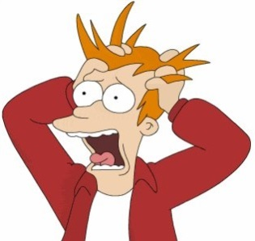
Stress

Slide 8
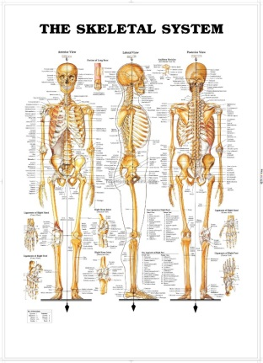
Something to do with ergonomics/ biomechanics/ posture/ position when playing

Slide 9
Route to Health
Health Problem
Predisposed
Health Outcome
Susceptible
Internal Factors
EVERYTHING about you!
External Factors
Addressing the
health problems
Inciting Event
change
Adapted from: Meeuwisse et al., 2007
Notes:
Favourite Slide

Slide 10
The Musical Athlete

Slide 11

Top Tips for Performers from Dance and Sports Science
Daily
Long term

Slide 12
Daily
PREPARE: Before playing:
(practise / rehearsal / performance):
Warm up
Dynamic stretches / Limber up / Get moving
SUSTAIN: During playing:
Re-set posture/ Let go of accumulating tension /
take breaks / hydrate
RECOVER: After playing:
Sustained (held) ‘Counter’ Stretches

Slide 13


Slide 14
Longer Term
The Benefits to playing/performing of increasing your physical condition:
Cardiovascular Conditioning
Strength training - endurance
Flexibility of soft tissues.

Slide 15
Route to Health
Health Problem
Predisposed
Health Outcome
Susceptible
Internal Factors
External Factors
Everything that you do / lands on you
Addressing the
health problems
Inciting Event
change
Adapted from: Meeuwisse et al., 2007
Notes:
Favourite Slide

Slide 16
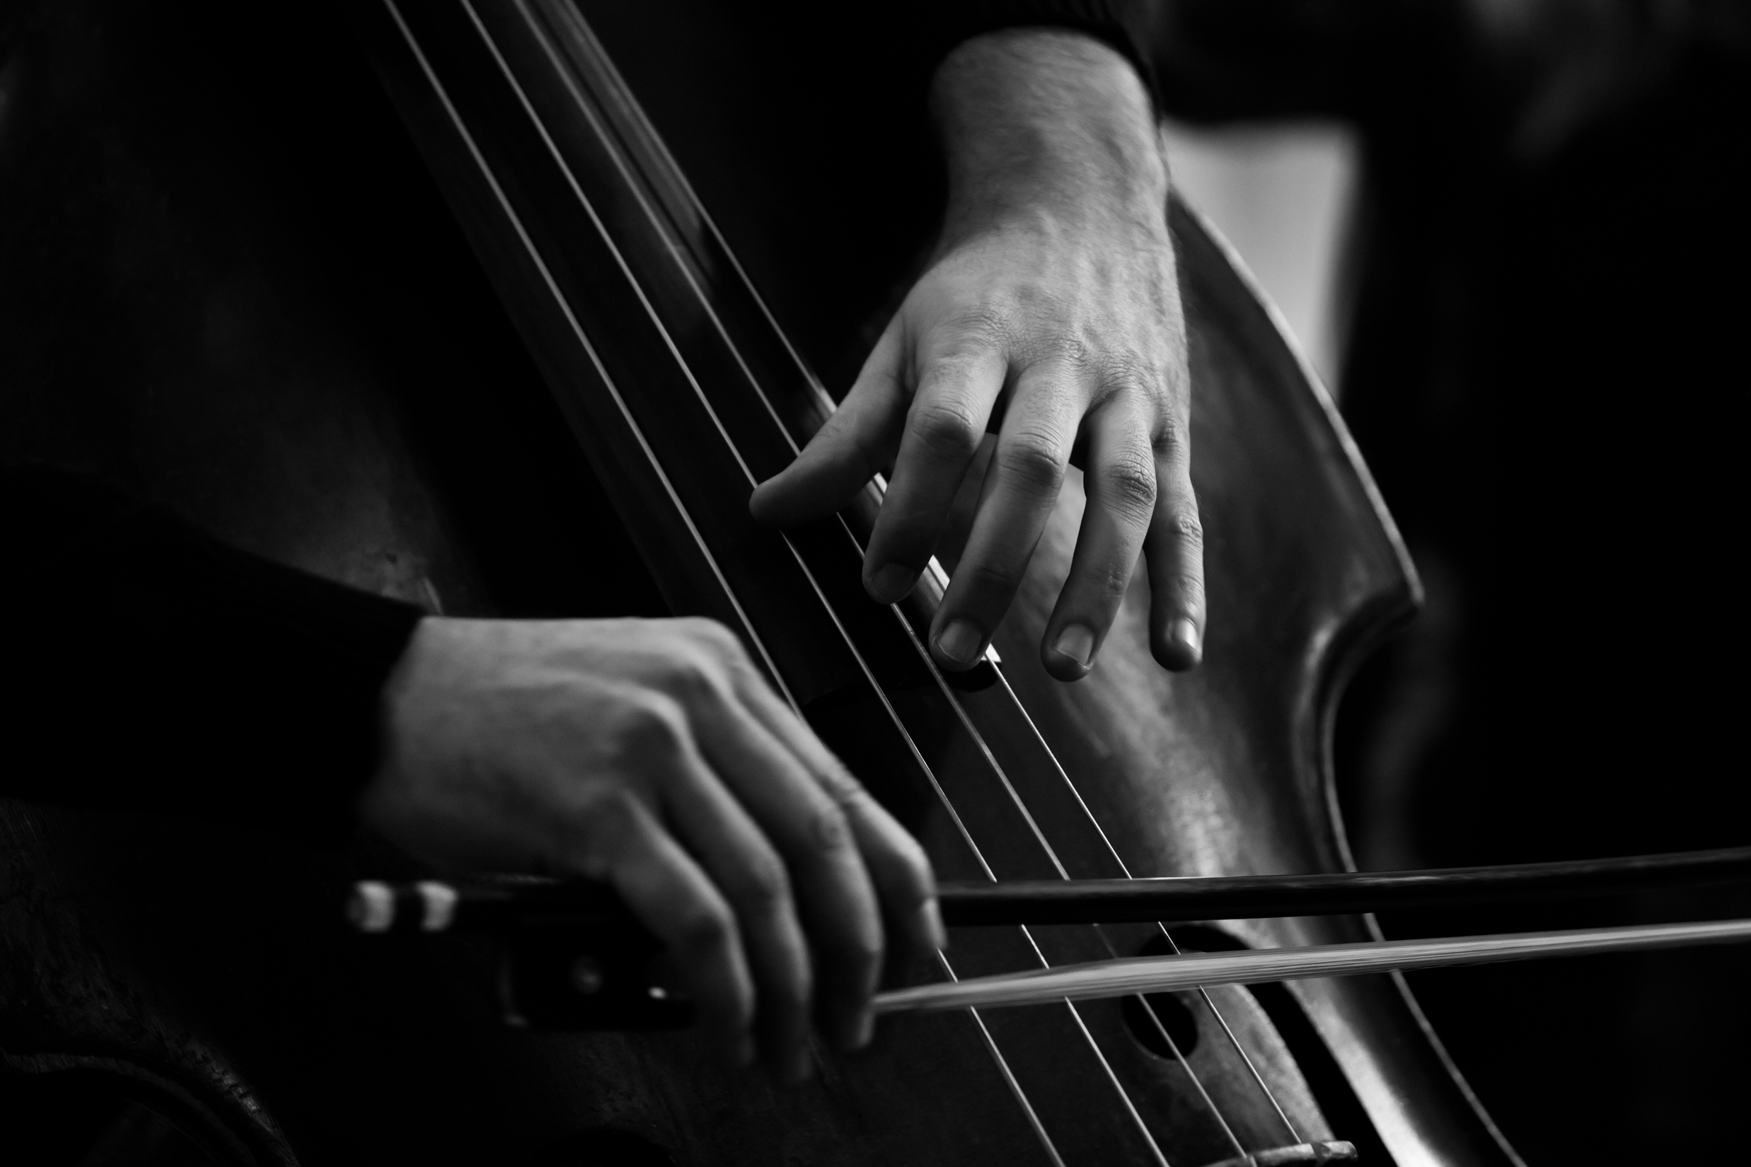



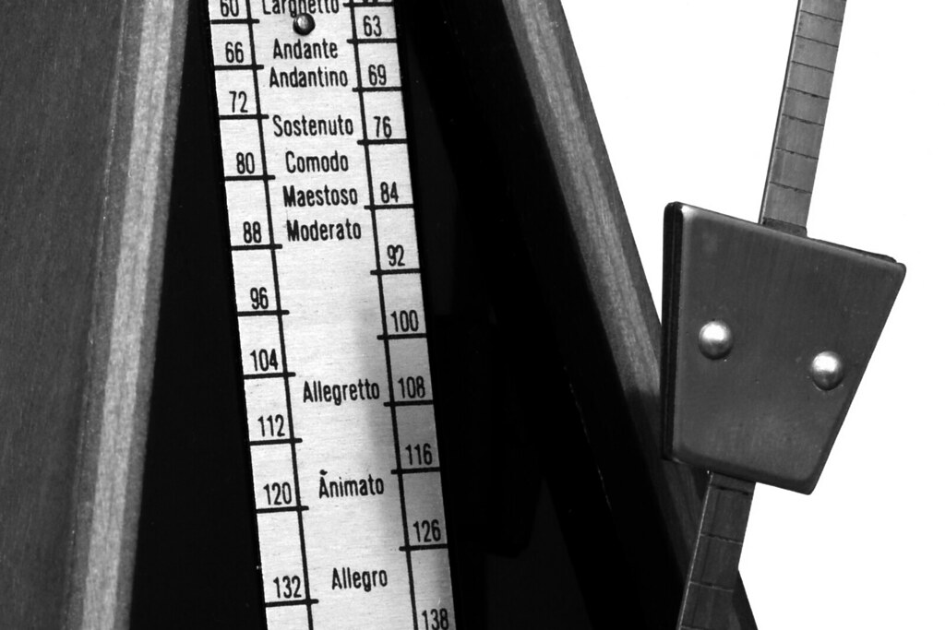

Load Management
This Photo by Unknown Author is licensed under CC BY-NC-ND

Slide 17
Playing Load
Time
Content
Its relationship to everything else

Slide 18
Additional Loads
Work environment
Work terms and conditions
Programming
Scheduling
Portfolio Careers

Slide 19
Additional Loads
Time spent on a computer / phone / other device
(includes social media, gaming, composing, producing, scheduling, invoicing, etc)
Other hobbies / activities / sports

Slide 20
Relevance of the Physical Health
Agenda
Health Problem
Health Outcome
Addressing the
health problems
Inciting Event
change
Adapted from: Meeuwisse et al., 2007
Notes:
Favourite Slide

Slide 21
Route to Health
Health Problem
Predisposed
Health Outcome
Susceptible
Internal Factors
External Factors
Addressing the
health problems
Inciting Event
change
Adapted from: Meeuwisse et al., 2007
Notes:
Favourite Slide

Slide 22
Physical Health Agenda
Music Opportunities Pilot (Liverpool)
Royal College of Music
Junior Dept
National Children’s Orchestra

