Slide 1
Working Well in the Creative Industries: Staying Creative for Longer. Exploring the intersection of health, work, and creativity
Laura Friedner
Director of People and Culture
National Theatre

Slide 2
The National Theatre Approach – Key principles
We recognise that the health, safety and wellbeing of our staff, performers and creative colleagues are fundamental to sustaining a thriving and creative organisation.
Our approach centres on providing robust, compassionate and accessible support that enables people to do their best work while feeling valued, safe and cared for.

Slide 3
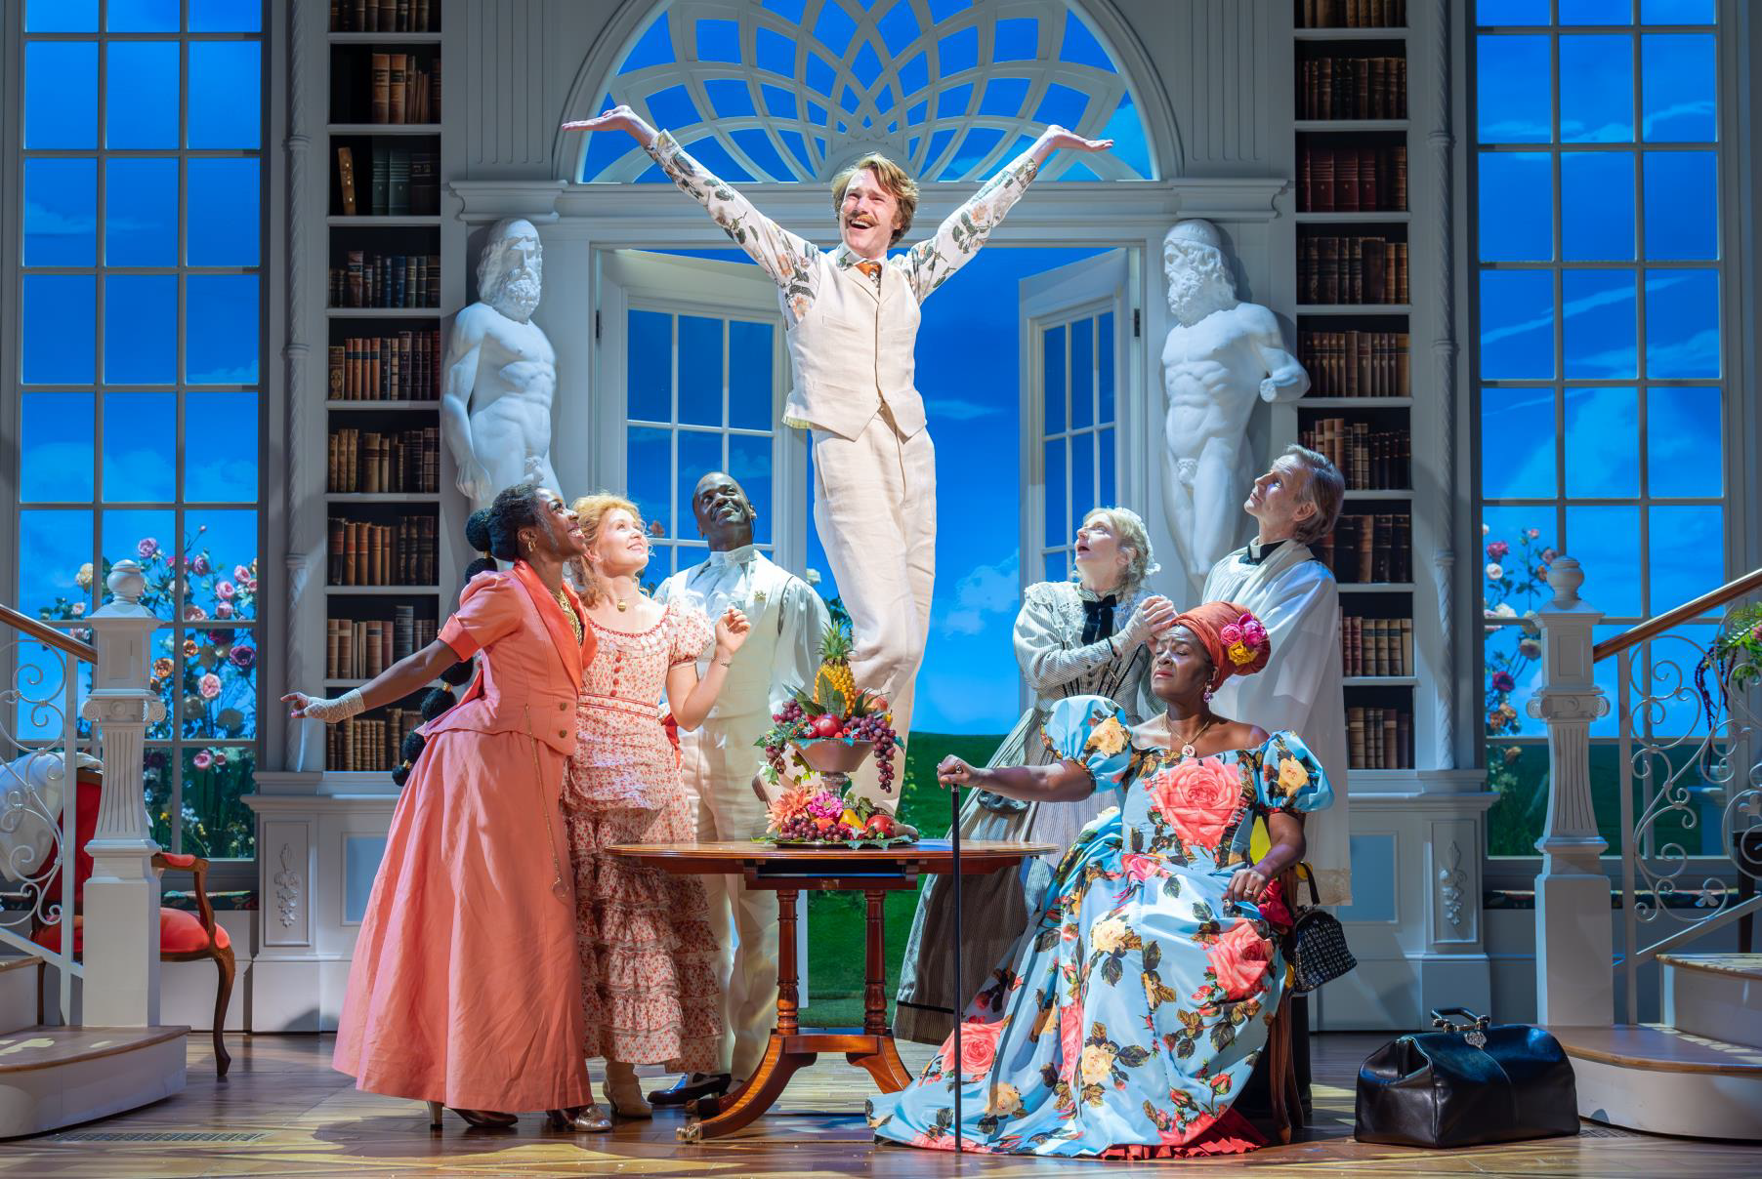
The National Theatre Approach - Action
OHU
Welfare & Wellbeing
Production specific
Health, Safety & Safeguarding
Inclusive Culture

Slide 4
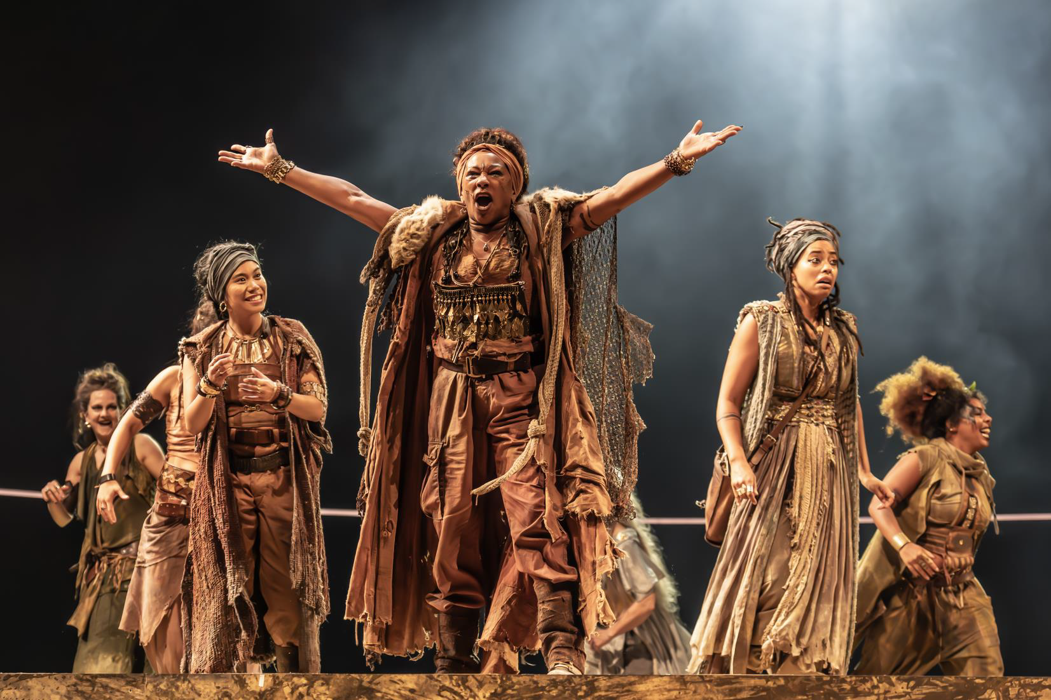
OHU
Employment medicals
Guidance on adjustments
Ongoing case management
Return‑to‑work plans
Health surveillance for both physical and emotional performance‑related needs
Extended support around rehearsals and shows, including outreach for touring or West End productions.

Slide 5
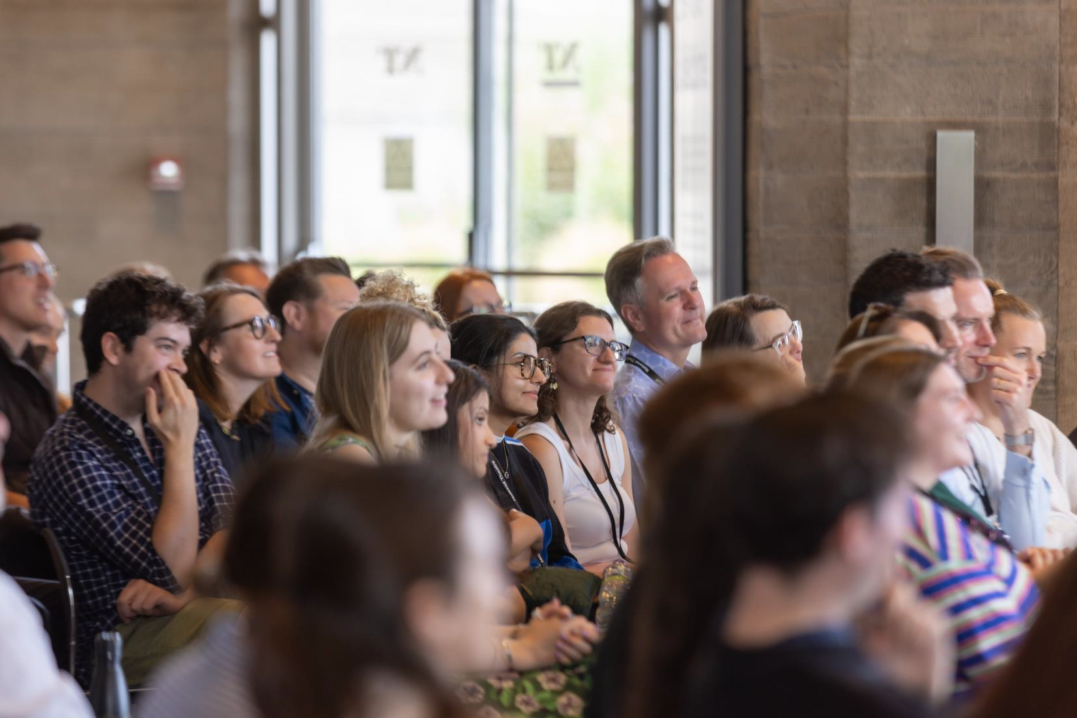
Welfare, Mental Health & Wellbeing Support
Wellbeing programme
Welfare 1:1s
Signposting

Slide 6
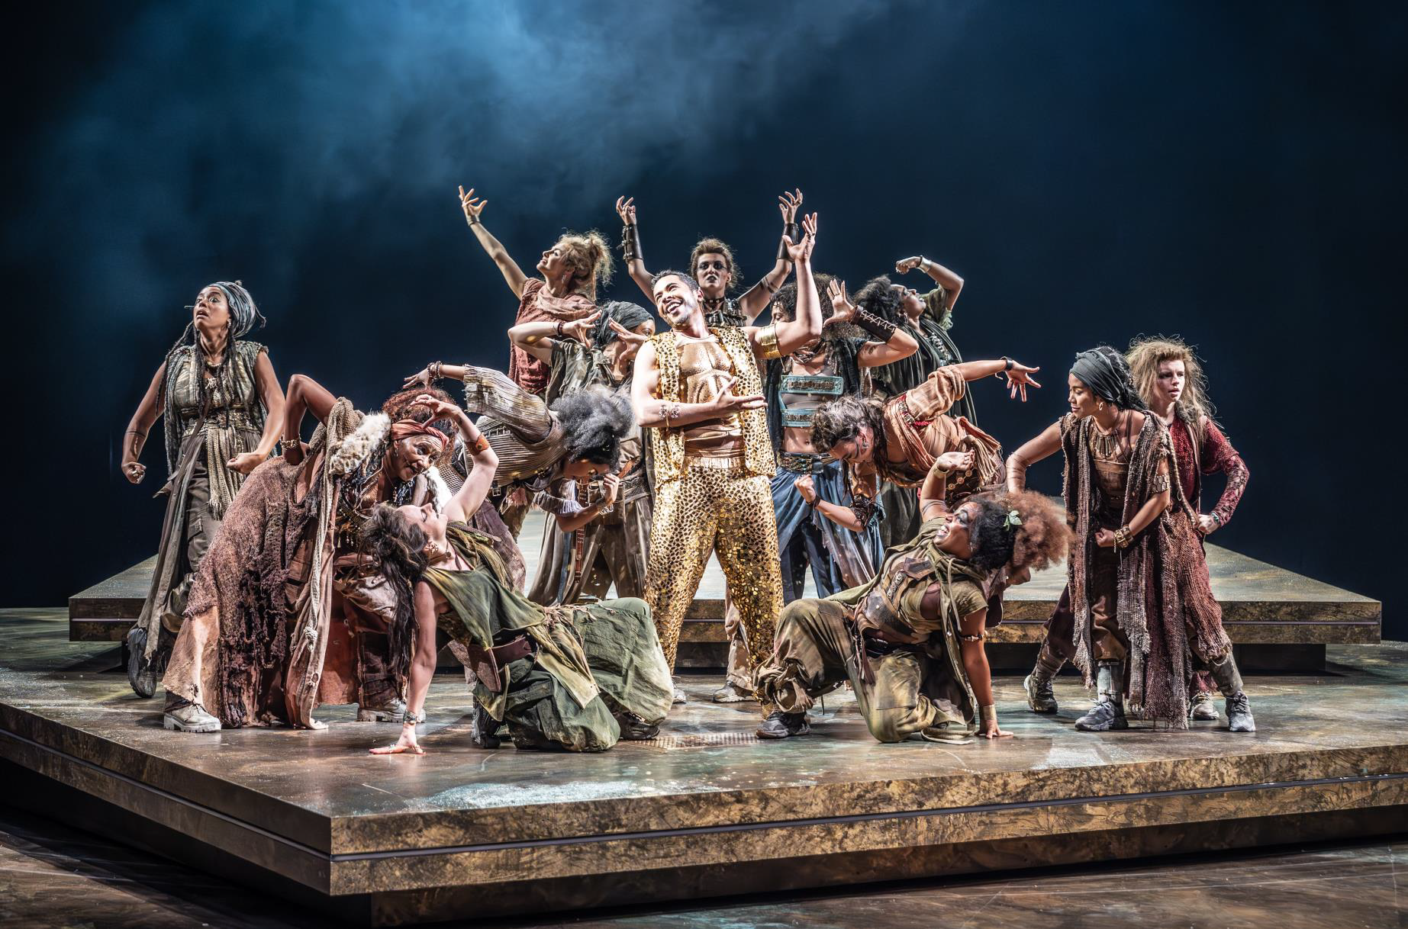
Specialist support for productions
De roling
Group work
Culture setting
Specialist support

Slide 7
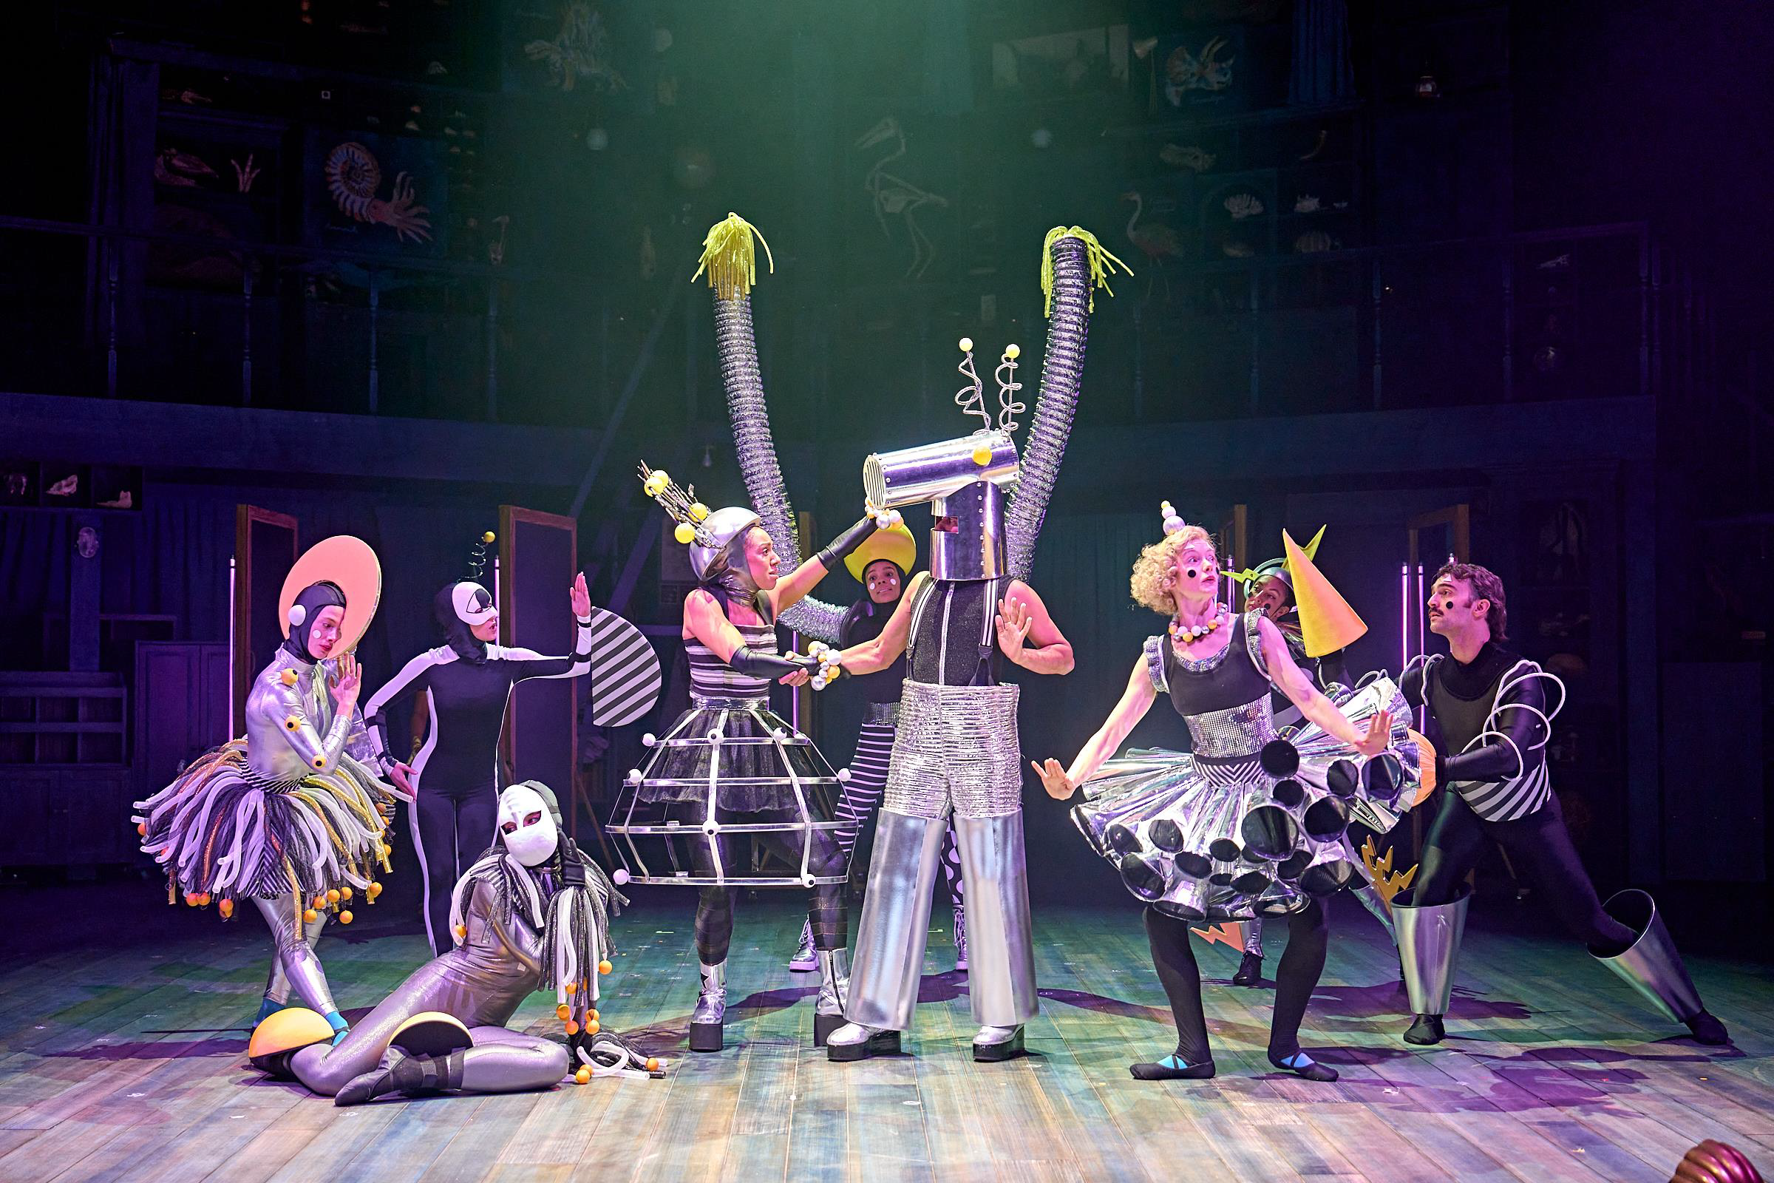
A strong culture of Health, Safety and Safeguarding
Clear reporting
Trained managers
Accessible policies
Mandatory training
Departmental leads

Slide 8
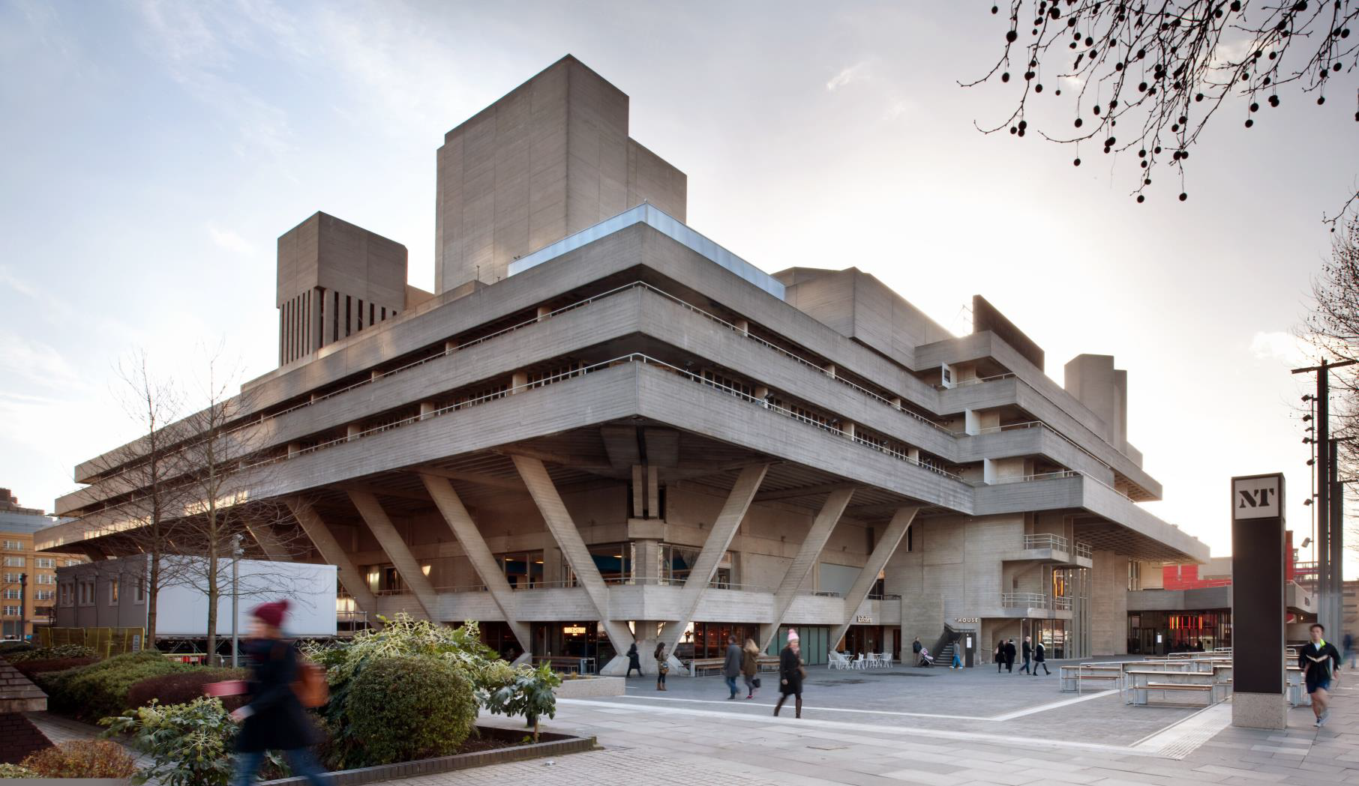
Inclusive culture
Staff networks
Training and Development
Management & Leadership
Internal comms
Accessible policies
Reporting mechanisms and clear signposting

Slide 9
NT specific programmes
Wellbeing programme follows the 5 Ways to Wellbeing.
Connect
Get Active
Take Notice
Learn
Give
Financial wellbeing sessions
Mental health ‘Skill Up’ sessions specifically tailored to working in the theatre
Health promotion days and opportunities to get active

Slide 10
The Role of Theatre in Health
Creating space for connection - a protective factor against loneliness and poor mental health
Encouraging empathy and understanding through storytelling
Providing shared cultural experiences that support social wellbeing
Engaging schools, communities and national audiences through NT Live, touring, and digital platforms
Across NT activity - from artistic programming to education and sector‑wide networks — theatre is positioned as a force for emotional connection, community building, expression and shared experience that supports mental and social health.

Slide 11
Thank you
Prepared by Laura Friedner
Director of People and Culture
lfriedner@nationaltheatre.org.uk

