Slide 1
How creative industries support and enable good Mental Health in their workforce and the wider population.
Laura Friedner
Director of People & Culture
National Theatre

Slide 2
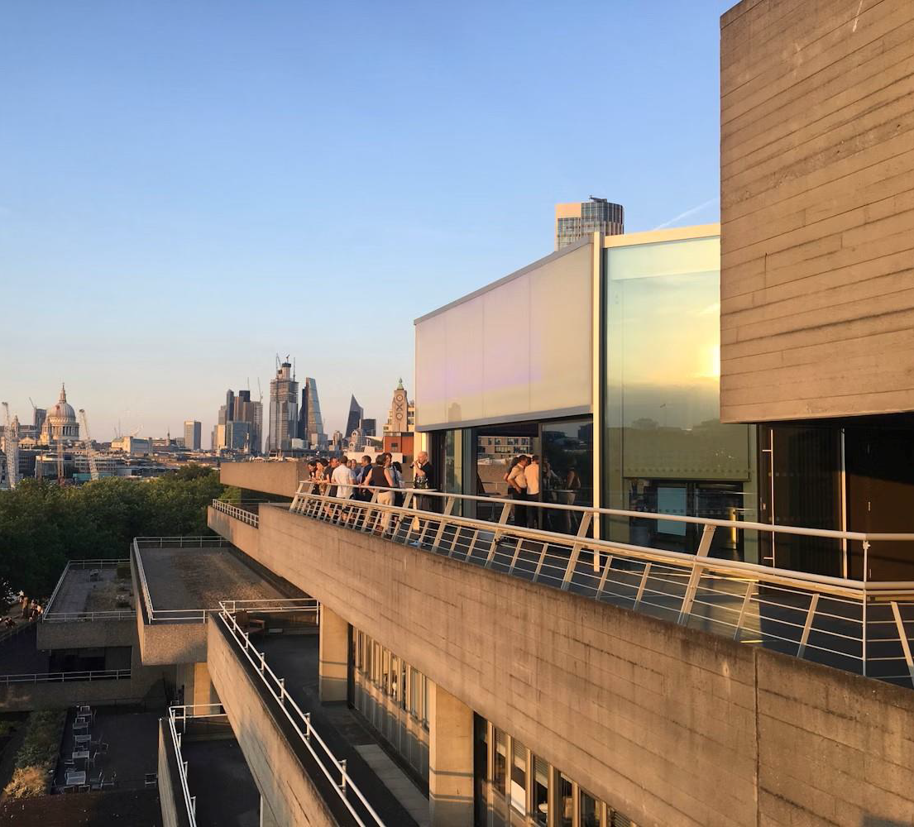
The challenge
Post pandemic pressures affecting people outside of work.
cost-of-living crisis
post-COVID isolation and grief
global conflicts
Two key drivers of mental health vulnerability
Financial stress
Isolation and loneliness

Slide 3
NT response
Year-Long Financial Wellbeing Programme for and tailored to, freelancers and staff
Wider organisational wellbeing programme
Reflective Spaces initiative
Mental Health First Aid provision (in particular for our public facing roles)
An in-house welfare team offering one-to-one support
A feedback loop from individual sessions into wider preventative wellbeing initiatives
Robust reporting mechanisms – Bullying and Harassment
Strong Health, Safety & Safeguarding culture
Training and development Inc. mandatory training
Workforce voice & engagement
Management and leadership training run by an organisational psychologist focusing on person centred management styles, encouraging self-reflection from leaders
Ongoing interrogation of how power, pace and pressure are experienced across the organisation

Slide 4
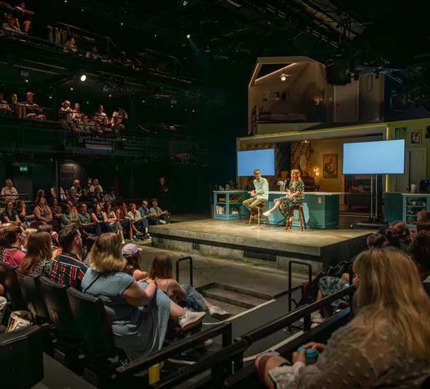
Wellbeing programme
Wellbeing programme follows the 5 Ways to Wellbeing.
Connect
Get Active
Take Notice
Learn
Give
Financial wellbeing sessions
Mental health ‘Skill Up’ sessions specifically tailored to working in the theatre
Health promotion days and opportunities to get active

Slide 5
1:1 sessions
Free and confidential
Mental health practitioners
Confidential facilitated spaces
Response to external pressures and global events
Welfare
Reflective spaces

Slide 6
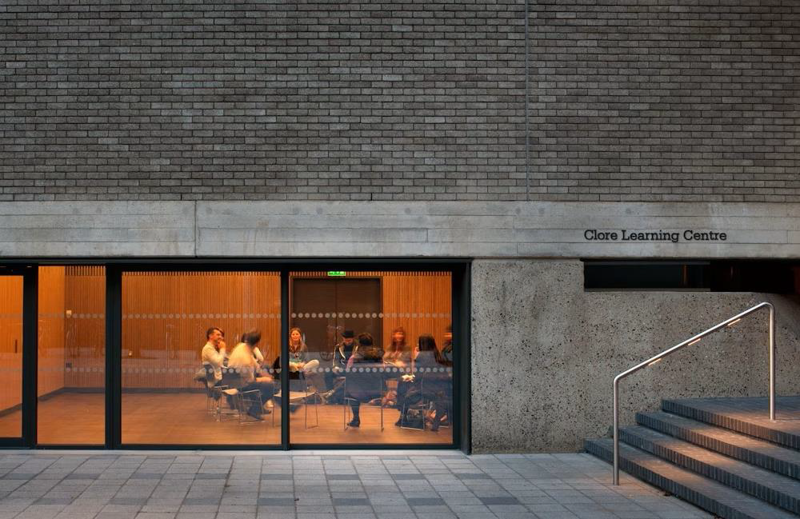
Long-term conditions
Work with the social model of disability
In house OH provision - provides continuity of care and known history
Ongoing regular support or onward referral
Tailored interventions based on knowledge and history of individual and dept
Understanding challenges on health issues relating to performance
Longer shifts allow for support up to and beyond curtain up
Outreach support for tours/West End and other smaller theatres
Presence in rehearsals to identify early any issues

Slide 7
Thank you
Prepared by Laura Friedner
Director of People and Culture
lfriedner@nationaltheatre.org.uk

