Slide 1

BITC/PHE Toolkit Suite for Employers ln Thornburrow
Louise Aston, Wellbeing Director
In association with Supported by
Notes:
About BITC and aim of campaign.
Positioning mental health as a continuum – suicide is at the sharp end of the spectrum.
Responsible Business Week – why is wellbeing part of CSR?

Slide 2
Taking a whole person, whole system approach
Embedding mental health policies into the organisational culture;
Embedding mental health policies into the organisational culture;

Slide 3
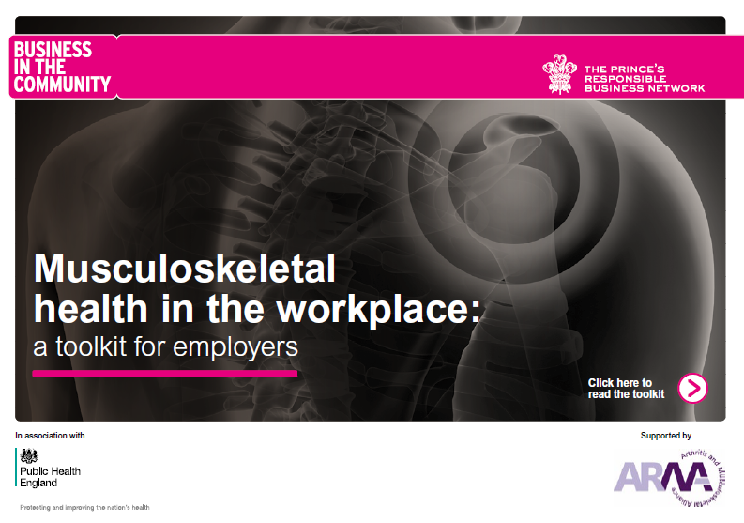
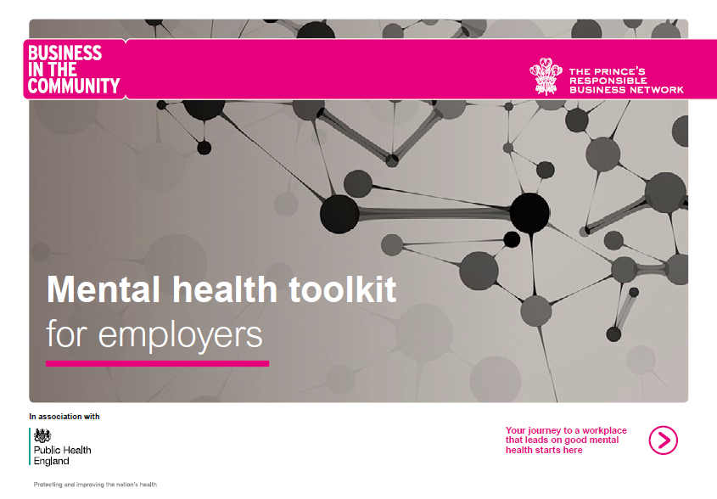
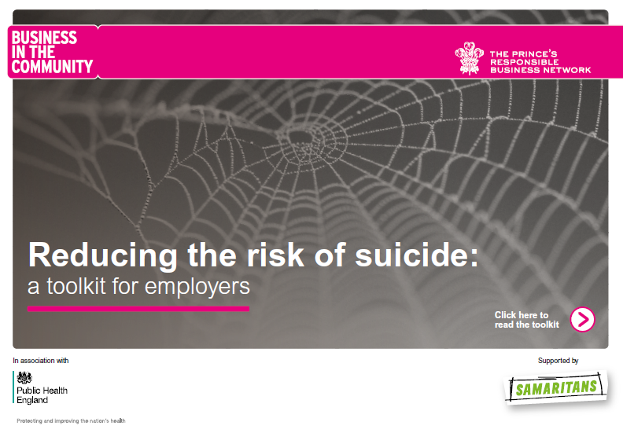
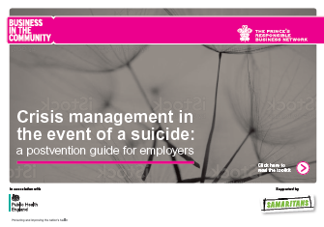
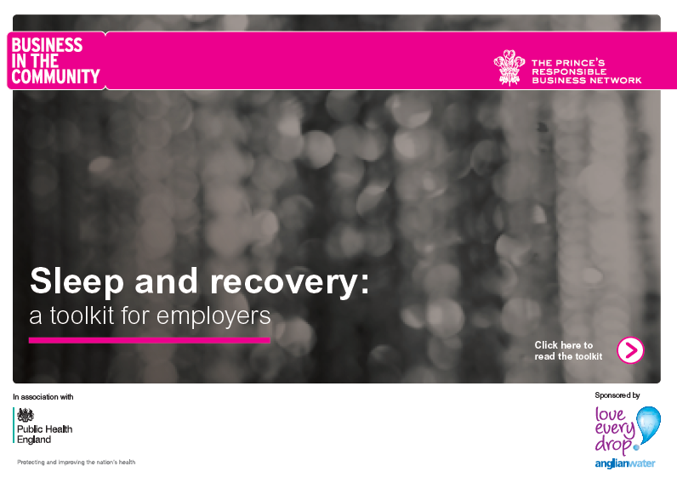
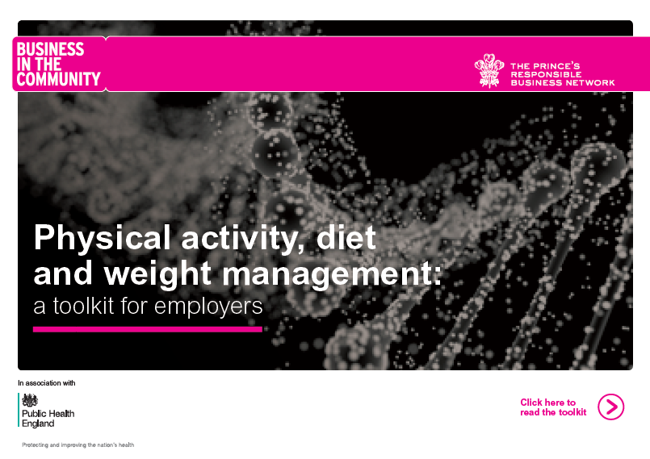
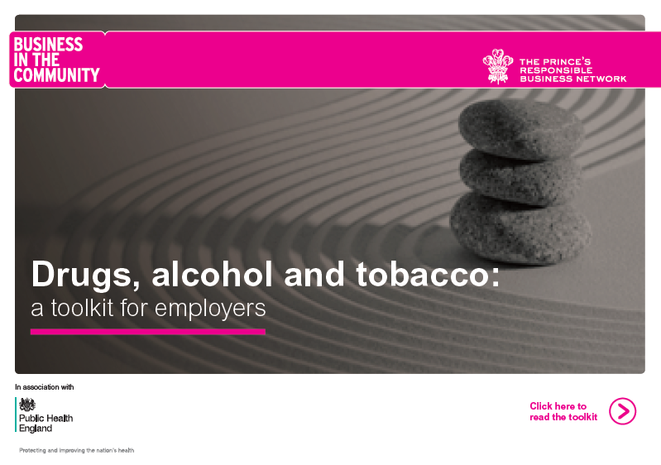
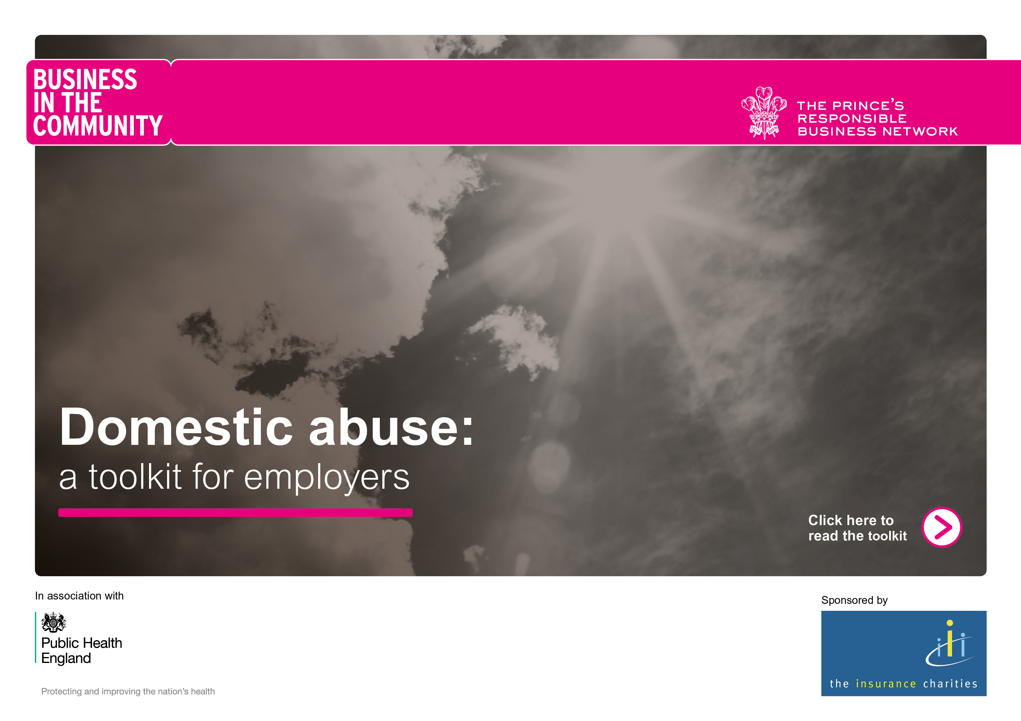
An interconnected toolkit suite for employers
Notes:
There is no health without mental health
Physical, mental and social wellbeing inextricably linked
There is no health without mental health
Increasingly crowded market of freely available resources
Consolidating best practice aligned to freely available resources
Employers sometimes don’t know where to start
Objective of retaining people in work at peak performance
Critical role of employers, parallel to pensions crisis
Mental health is a common thread across all the toolkits
Consolidates best evidence along with best employer practice aligned with freely available resources
Take a whole person, whole system approach to embedding wellbeing into organisational culture
Business in the Community and Public Health England have collaborated to create a suite of interconnecting toolkits focusing on mental and musculoskeletal health – the two leading causes of lost days at work.
The suite consolidates best practice, expert comment, case studies, freely available resources and is relevant to all employers, irrespective of your size, sector or stage on your journey.
Our suicide toolkits on prevention and crisis management in the event of a suicide, are supported by Samaritans and take a deep dive into the sharp end of the mental health spectrum.
Together, they give advice on how to evaluate suicide risk, how to recognise signs of risk escalation, and how to respond to a crisis.
Acknowledging that suicide risk can never be eliminated, the toolkits also guide employers through the process of responding to a workplace suicide, not just in the immediate aftermath, but in the following weeks and months when the impact is likely to still be felt.
Throughout the toolkits there is a focus on the role of line managers, who play a crucial role in the implementation of a suicide prevention strategy.
They also stress the importance of leadership, encouraging senior executives to demonstrate their own commitment to good mental health.
But what matters most is fostering an environment in which employees can talk openly about their mental health and wellbeing, just as they do about physical health, without fear of discrimination or abuse.
The toolkits are informed by the lived experience of dozens of organisations, who were willing to share their learnings for the benefit of others.
Many talked openly about the pain and sorrow caused by the sudden deaths of colleagues, and about their determination to do whatever they could to reduce the risk of another suicide.

Slide 4

Aligned to implementing 6 Core Mental Health Standards
Notes:
Aligned to implementing 6 core mental health standards from Stevenson Farmer Review

Slide 5
Suicide prevention and postvention
Notes:
Suicide – a risk for all employers
Acute end of the mental health spectrum

Slide 6
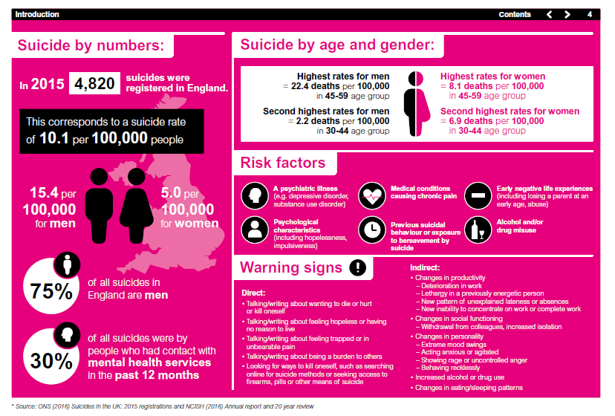
Notes:
Suicide – the issue
More than 4,800 suicides were registered in England in 2015 - that means someone took their own life every two hours.
It is a stunning and sad statistic, and one that should make us all pause to reflect, and consider how we can all make a difference to bring this down.
For employers, although rare, there is the risk that your organisation will be affected by suicide, either through the death of an
employee or of someone who has a significant role connected to the business.
Suicide is an issue for everyone.
When a colleague dies by suicide, it often comes as a devastating and unexpected shock, leaving the deepest sense of loss,
one from which we struggle to recover and the impact is felt across the whole organisation.

Slide 7
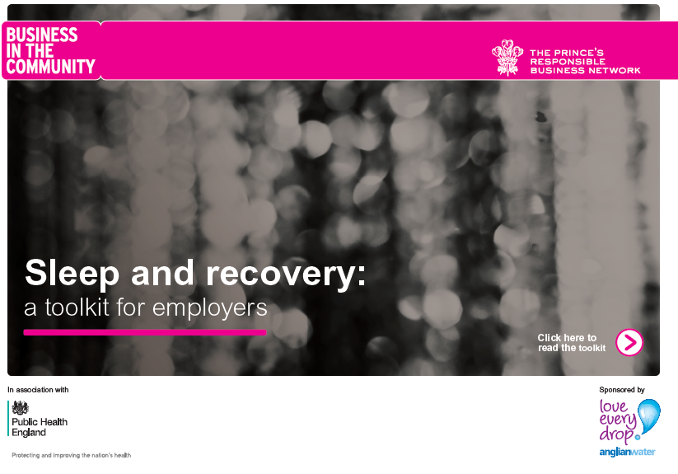
Notes:
Why is sleep emerging as a hot topic for employers?

Slide 8

24/7 digital economy
“”Life has never been as fast as it is today
and it will never be this slow again”
“”Digital tech is the new coffee, it cannot be un-invented and is hard to restrict. The genie cannot be put back in the bottle”
Notes:
The 24/7 digital economy has brought us many good things, creating jobs and prosperity.
But the downside is that we it’s created always on culture.
The dividing line between our work and our life outside work has blurred.
In a connected society, we are always switched on.

Slide 9
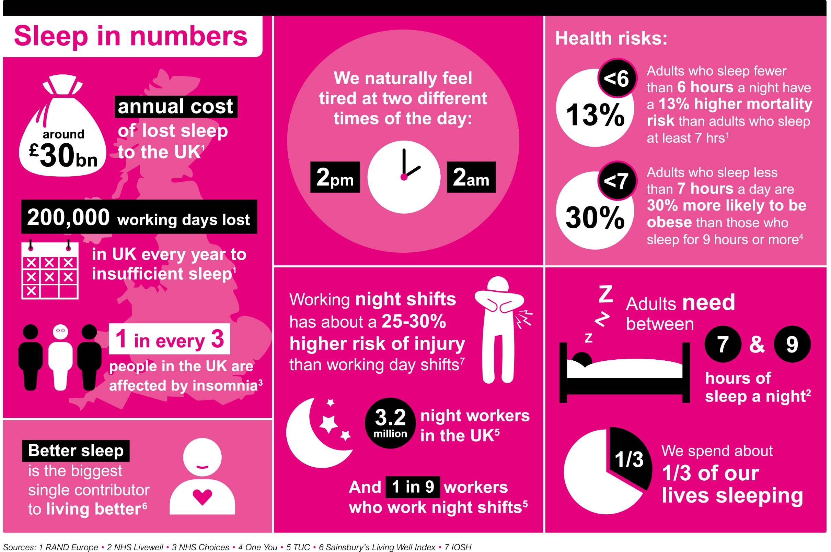
Notes:
Louise
So, here’s an overview of sleep in numbers.
There’s a compelling business case for sleep, with an annual cost of £30bn due to insufficient sleep and 200,000 working days lost in the UK.
Adults need between 7 & 9 hours of sleep a night which amounts to spending a third of our lives sleeping.
Adults who sleep fewer than 6 hours a night have a 13% mortality risk than adults who sleep at least 7 hours.
Adults who sleep less than 7 hours a day are 30% more likely to be obese than those who sleep for 9 hours or more.
As Sainsbury’s Living Well Index highlighted, sleep is the biggest single contributor to living better.

Slide 12

Notes:
Each toolkit has useful, freely available resources and case studies featuring best practice.
Prevention
PWC
Anonymous medical doctor
AWG
Armed Forces
BT
Mercer
Santander
Postvention

Slide 13
Resources for employers
Notes:
Louise

Slide 14
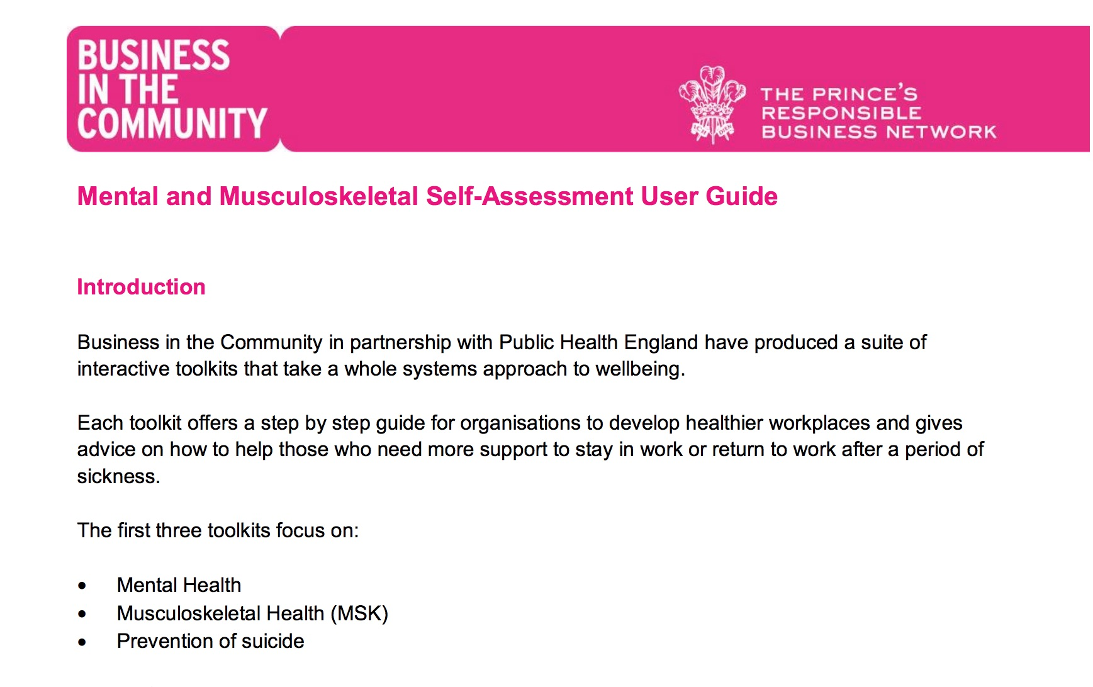
Toolkit self-assessment tool

Slide 15
Total downloads to date – 28,549
Toolkit | Launch Date | Number of times downloaded 9As of May 2018)
Mental Health | May ‘16 | 13,648
Suicide Prevention | March ‘17 | 4,088
MSK | March ‘17 | 3,700
Suicide Postvention | March ‘17 | 2,234
Sleep and Recovery | Jan ‘18 | 4,446
Physical activity and healthy eating | Feb ‘18 | 433

Slide 16

Survey | Sample | Main finding
PHE BITC Toolkits for Employers – HR decision makers | 500 HR decision makers in private sector businesses with 10 or more employees | 26% of HR decision makers surveyed had heard of the PHE BITC Toolkits for Employers Of those who had heard of the toolkits, 72% of HR decision makers rated the quality of the toolkits as “fairly good” or “very good”. 73% of HR decision makers would recommend the toolkits to other employers.
PHE BITC Toolkits for Employers – decision makers | 591 senior decision makers in private sector businesses | 9% (53) had heard of PHE BITC Toolkits, of those that had heard of them through training or word of mouth in the workplace. Of those who had heard of the toolkits, 52% of business of all sizes rated the quality of the toolkits as “fairly good” or “very good”. 70% of those who had heard of them would recommend the toolkits to other employers.

